Slide 1


Quantag Studio
Productive Quantum Software Solution
© Quantag IT Solutions GmbH 2024

Slide 2
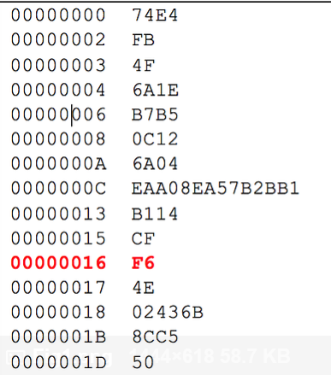
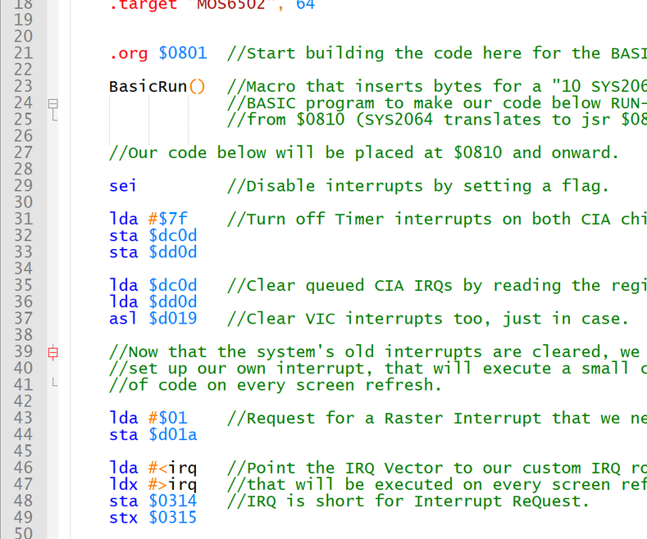
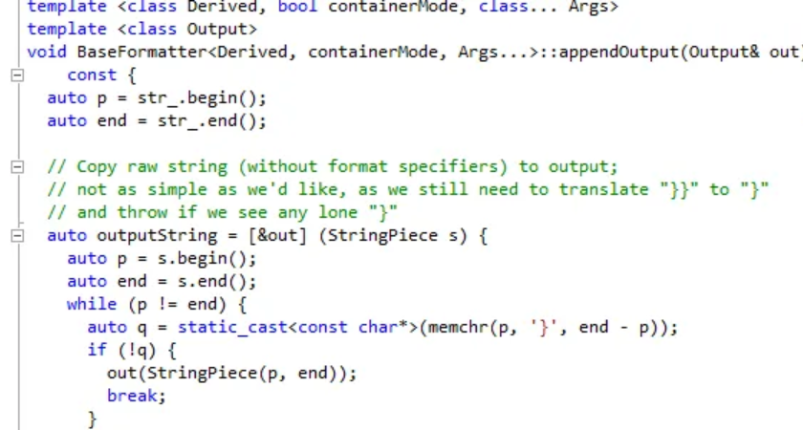
Classic Development Stack
Source Code
Assembler
Hardware Code

Slide 3
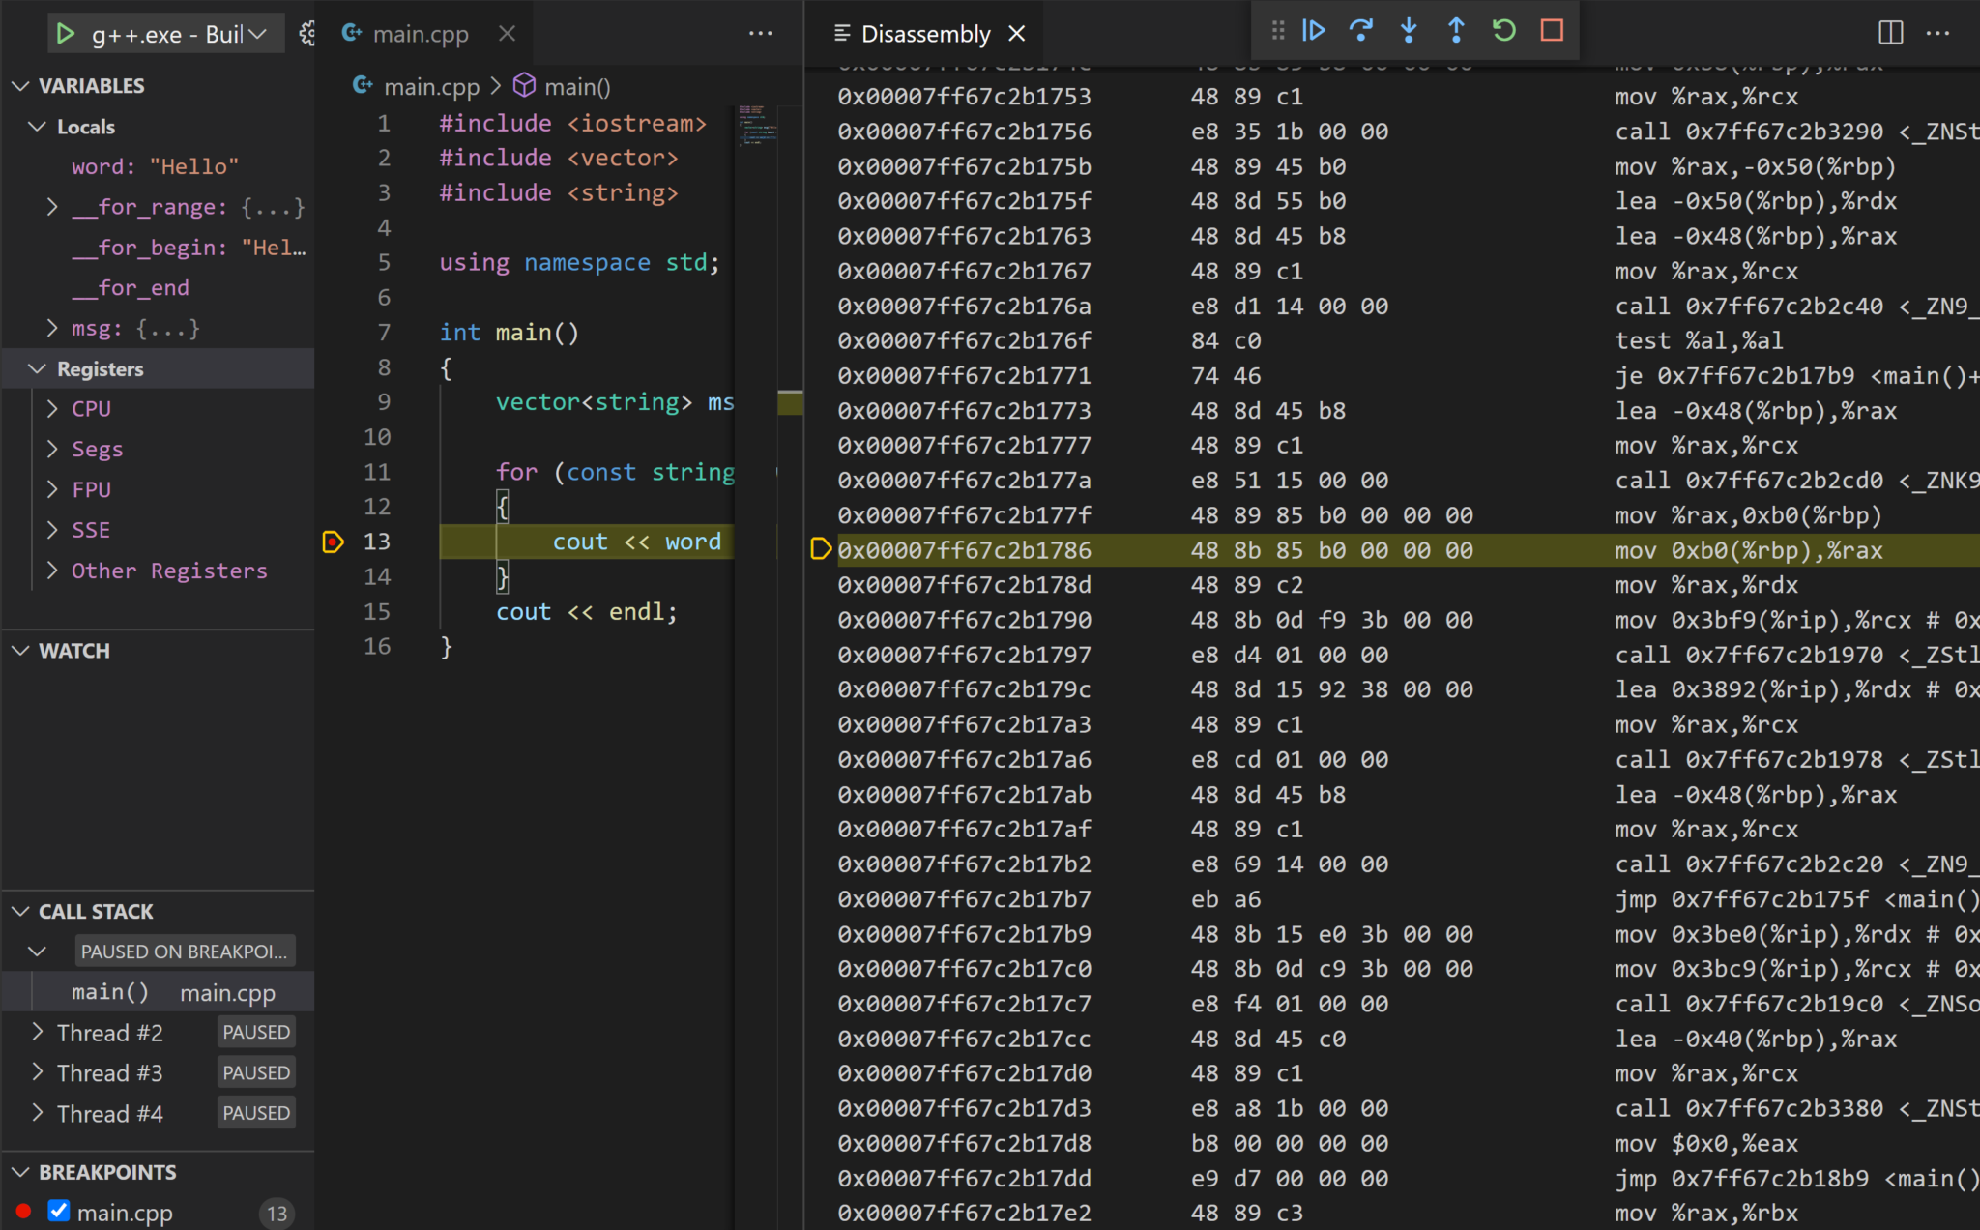
Classic Development Stack – IDE integration

Slide 4
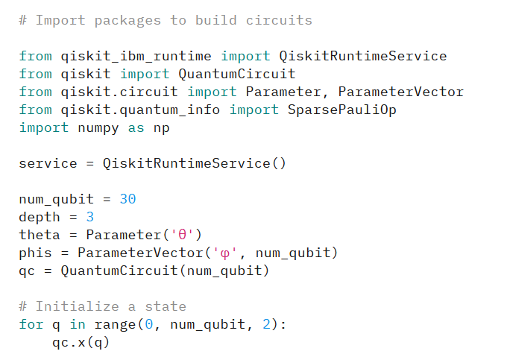
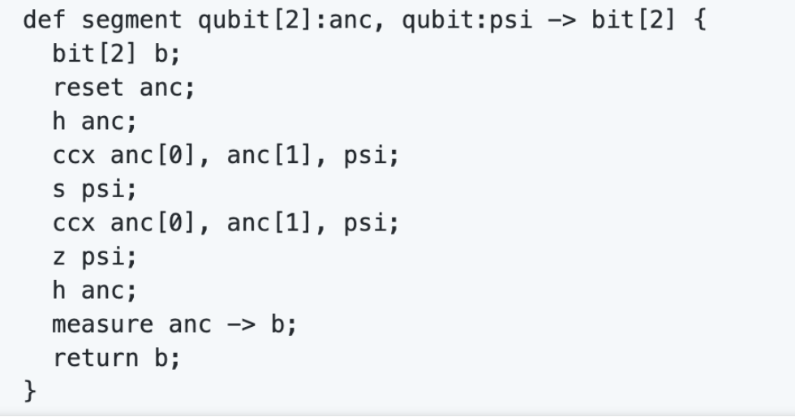
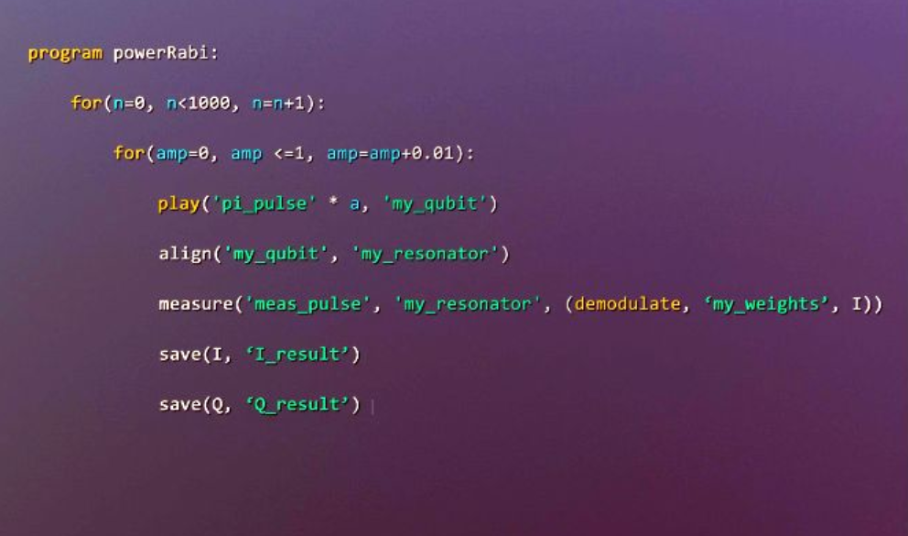

Quantum Development Stack
Source Code
Assembler
Hardware Code
OpenQASM
QIR

Slide 5
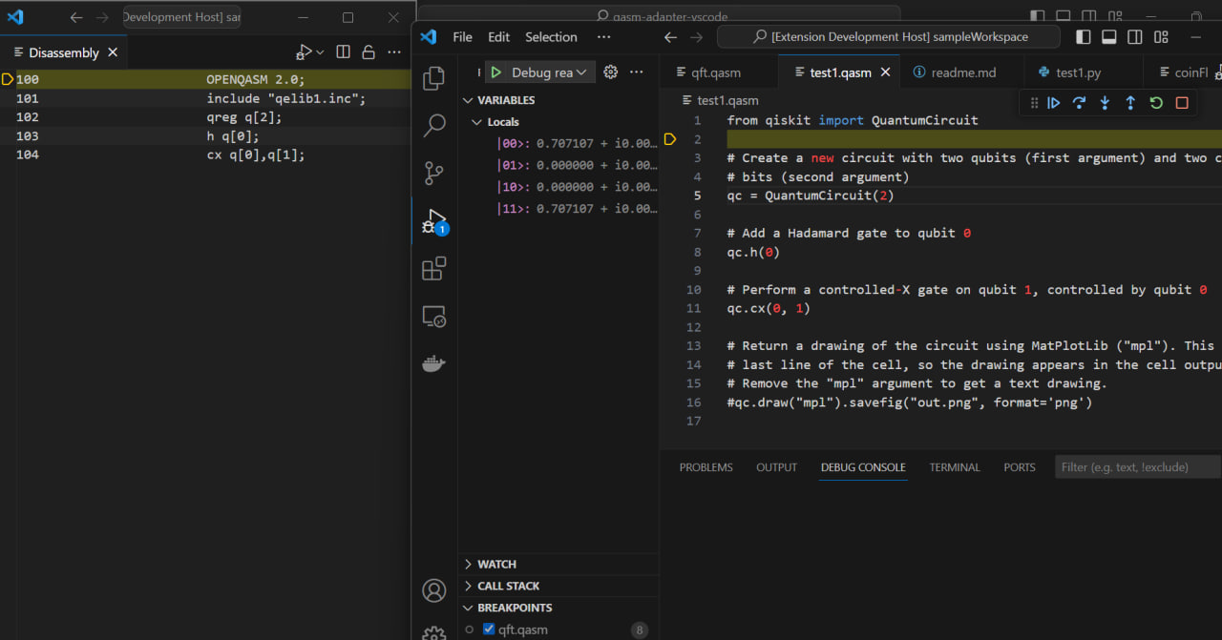
Quantum Development Stack – IDE integration

Slide 6
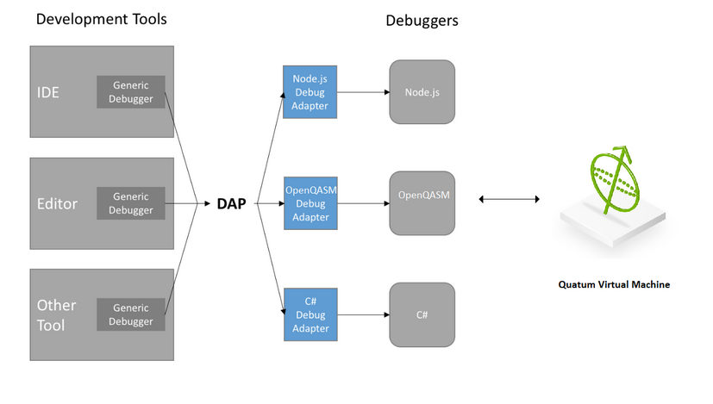
How does it work
Implements:
- Debugger Adapter Protocol
- Language Server Protocol
Supports:
- hardware accelerated simulators

Slide 7
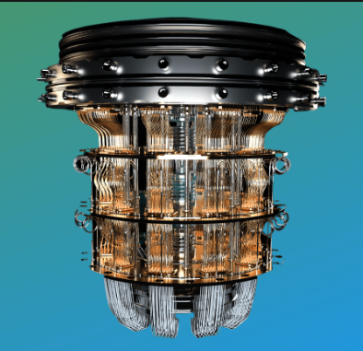
How does it work
QVM
IDE
debugging
Simulator
QS Core
Quantum Hardware
executing

Slide 8
How does it work
Python Qiskit
OpenQASM
Circuit
Compression
QIR/BIN
Hardware

Slide 9
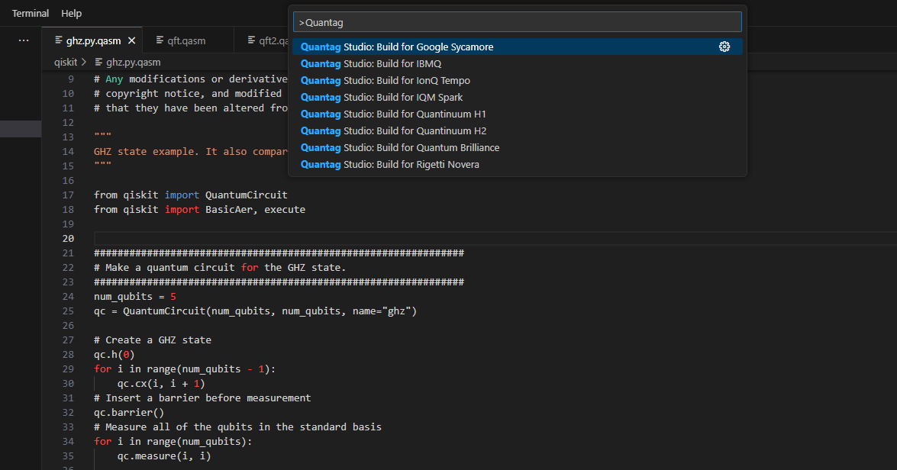
Build code for specific hardware

Slide 10
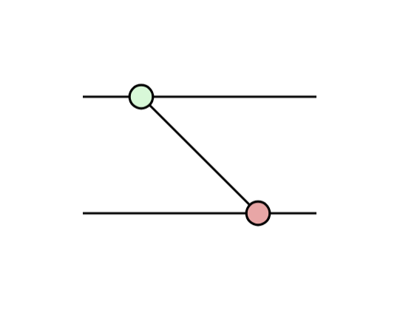
Circuit Optimization. ZX Calculus
https://zxcalculus.com/

Slide 11
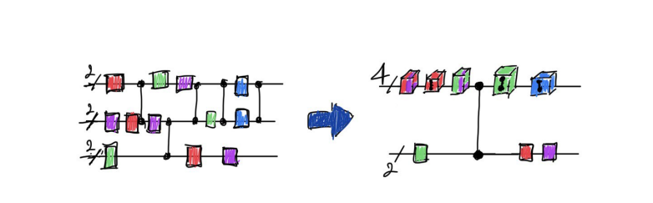
Circuit Compression. Qubits to Qudits
Compression of Qubit Circuits: Mapping to Mixed-Dimensional Quantum Systems
Kevin Mato, Stefan Hillmich, Robert Wille

Slide 12

Current status
Supported IDEs: Microsoft VS Code
Supported hardware: IBM, Zurich Instruments, Quantinuum
Supported frameworks: IBM Qiskit, Quantinuum pyTKET, Guppy
Supported QVM: QPP, nVidia CUDA-Q

